Slide 1
Platinum Data Project Wang Biyuan
2016.08.23 Presentation

Slide 2
Project Progress
Step I: Import data into MATLAB 【Implementing】
Step II: Data interpolation 【Implementing】
Step III: Data average 【Implementing】

Slide 3
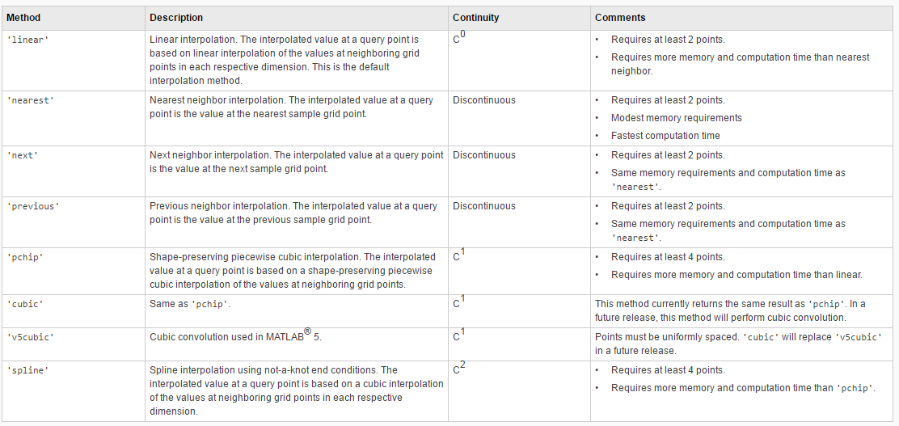
Project Progress
Introduction to piecewise interpolation methods (interp1)

Slide 4
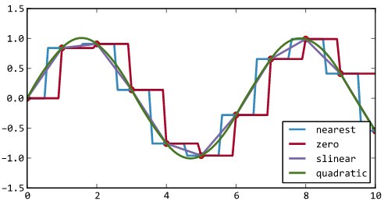
Project Progress
Introduction to piecewise interpolation methods

Slide 5
Project Progress
Piecewise linear interpolation
Pros: Convergence
Cons: Less smoothness
Compromise: Enough amount of sample points

Slide 6
Project Progress
Spline interpolation
Pros: Minise oscillations
Cons: Require more memeory / time consuming

Slide 7
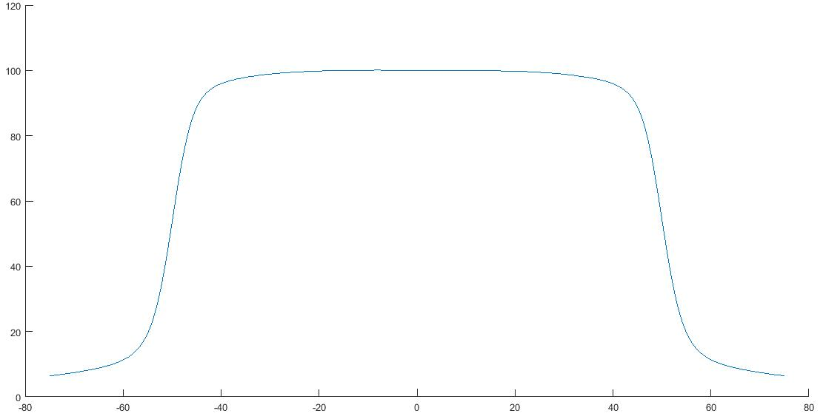
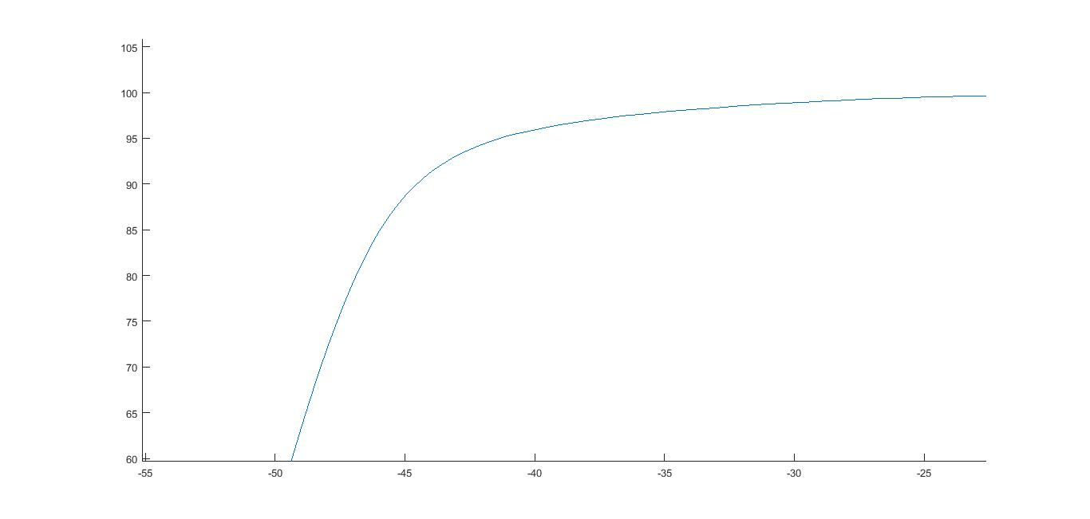
Project Progress
Linear
Linear zoom in

Slide 8
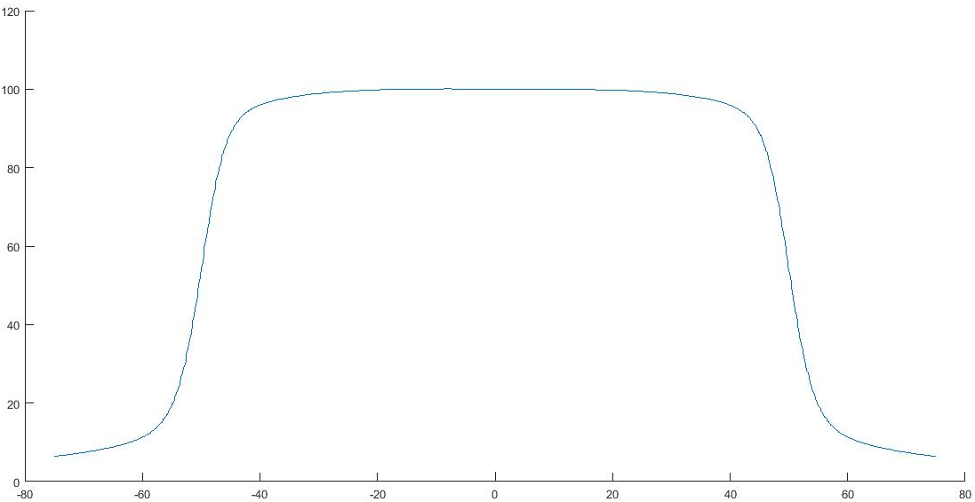
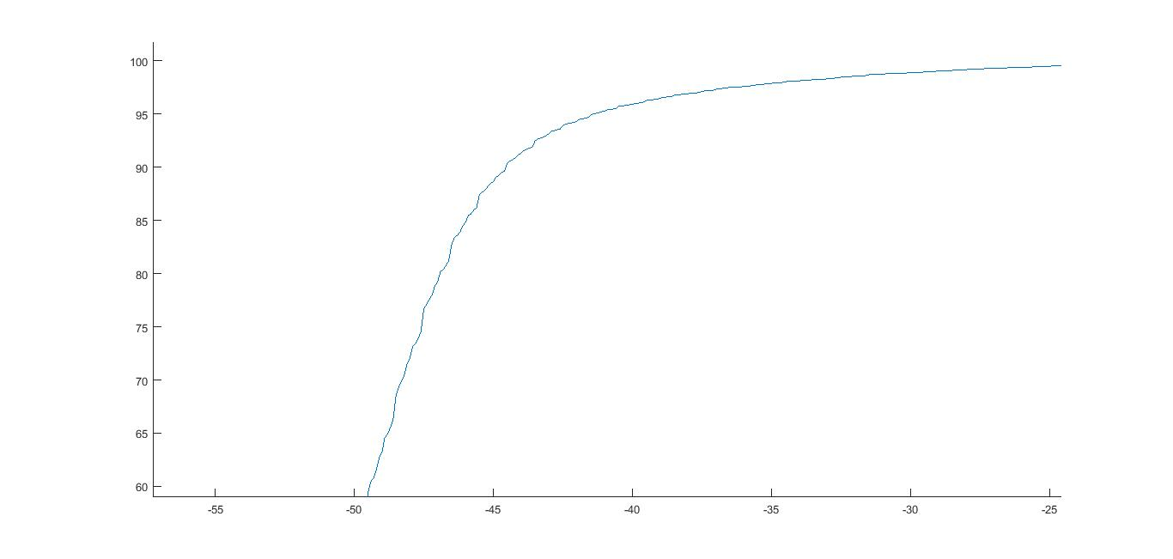
Project Progress
Nearest
Nearest zoom in

Slide 9
Reference
[1] Anon, (2016). Splines and Piecewise Interpolation. [online] Available at: http://citeseerx.ist.psu.edu/viewdoc/download?doi=10.1.1.713.6275&rep=rep1&type=pdf [Accessed 23 Aug. 2016].
[2] Mathworks.com. (2016). 1-D data interpolation (table lookup) - MATLAB interp1. [online] Available at: http://www.mathworks.com/help/matlab/ref/interp1.html [Accessed 23 Aug. 2016].
[3] Voidcn.com. (2016). 【python】一维二维插值 - 程序园. [online] Available at: http://www.voidcn.com/blog/huozi07/article/p-4987298.html [Accessed 23 Aug. 2016].
[4] <ruoyu0088@gmail.com>, H. (2016). Python科学计算第二版. [online] Zqdevres.qiniucdn.com. Available at: http://zqdevres.qiniucdn.com/data/20150507214117/index.html [Accessed 23 Aug. 2016].

Slide 10
Future Work Plan
Finish data of other energy levels and machine types
Put the averaged data back to .asc files

Slide 11
THE END Thank you for your patience!

